Slide 1
Exploring Dark Data
With SQL Server 2016 and R
Oliver Frost – Consolidata Ltd

Slide 2







Thanks to our sponsors!

Slide 3
Exploring Dark Data with SQL Server 2016 and R
What exactly is dark data? Why is it valuable?
What is R? Why should I learn it?
How to set up R inside SQL Server 2016?
Some examples of R inside SQL Server 2016
See an end-to-end streaming application using Azure Event Hubs, Streaming Analytics and R.
3 |

Slide 4
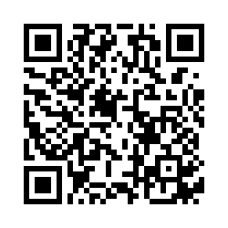
We care about your opinion! Please don't forget to rate this session
http://bit.ly/2fXGJNQ
We look forward to see you at the next event!
http://czechpass.org #CZBISQLPASS

Slide 5

Oliver Frost – SQL Server, R and Azure
Twitter: @ConsolidataLtd
www.consolidata.co.uk

Slide 6
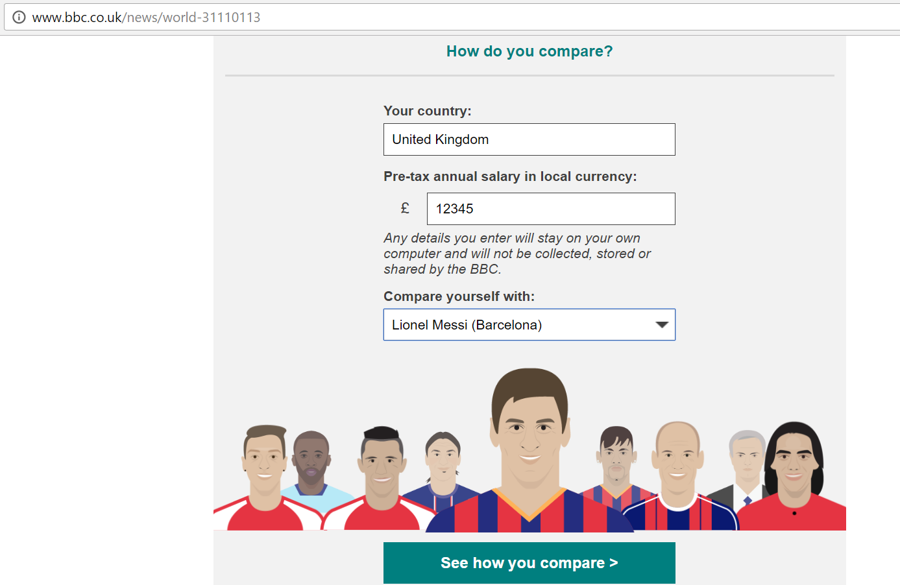
What is Dark Data?
It is an umbrella term, used to mean a number of different things.
One example it can refer to is ‘data leakage’.
BBC - footballer’s wages gaff on Twitter.
Amazon – deducing sales from publishing relevant position on other books
(A hat tip to Professor Mark Whitehorn!)

Slide 7


What is Dark Data?
Data that is being collected, but not being used.
“Information assets that organisations collect, process and store in the course of their regular business activities, but generally fail to use.” - Gartner
Customer comments on internet transactions – can you identify positive or negative sentiment without a feedback form?
Transaction logs – can you analyse your log files and predict when specific failures might occur?
Social media data – are you storing and analysing your network with more than intuition?

Slide 8
Why bother with Dark Data?
Data on its own isn’t valuable – data that can’t be analysed is worthless.
With new techniques and tools, semi-structured and unstructured data can be analysed to reap valuable new insights.
Dark data can provide potential new opportunities for customer analysis, performing predictive analytics and gaining a deeper understanding about your processes.
[Light Data + Dark Data = All Data]

Slide 9
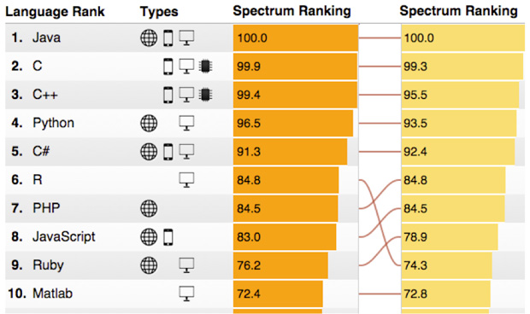
What is R?
An open-source, all-purpose programming language, popular among statisticians and data scientists.
Over 2000 packages available on CRAN.
It was ranked the 6th most popular programming language in 2015, and more and more people are contributing to it, ahead of JavaScript and Ruby.

Slide 10
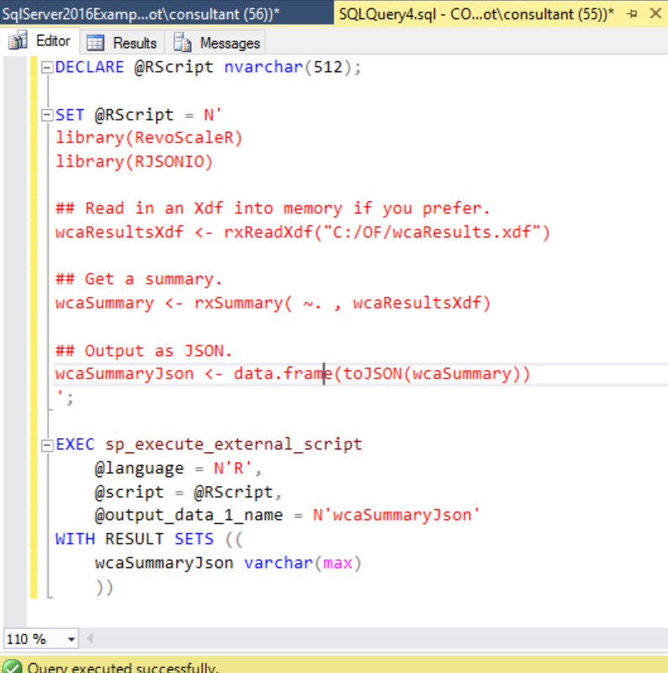
What can I do with R…
… that I can’t do with SQL?
Use ‘tidyverse’ packages to wrangle and clean data:
tidyr for data cleaning.
dplyr for reshaping data.
ggplot2 for data visualisation.
Rvest for web scraping, RHadoop for big data integration, sparklyr for running Spark jobs.
RevoScaleR for machine learning, predictive analytics, statistical modelling (all in SQL).

Slide 11
Summary - Why R?
Microsoft loves R!
Microsoft R Server overcomes some of the shortcoming of open source R for big data and data science.
In the next few years, knowing just SQL will not be enough.

Slide 12

Demos!
Any questions?

